Slide 1
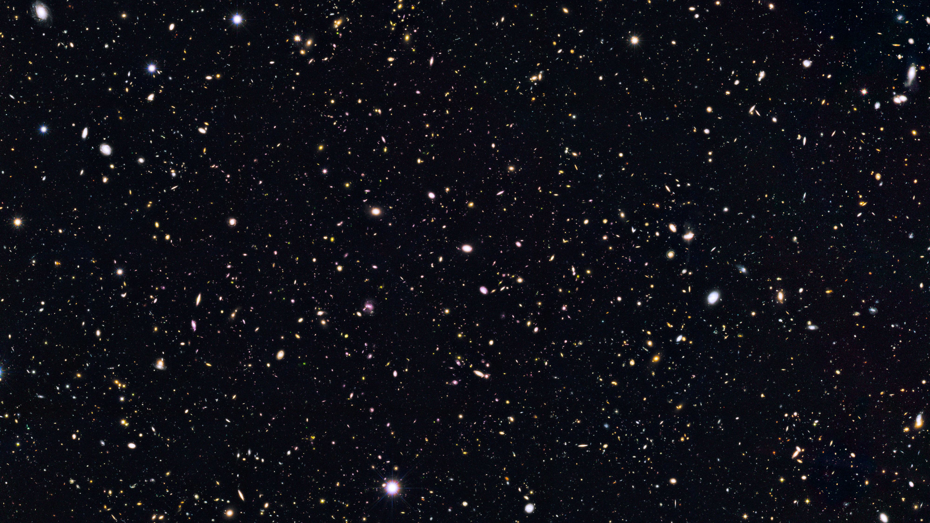



A Lyman Continuum-bright Quasar at Redshift z = 2.59
Cameron White, Brent Smith, and Rogier Windhorst

Slide 2
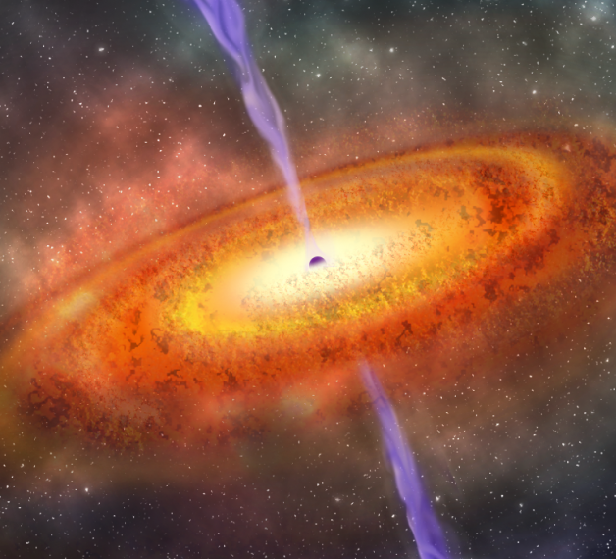
What is a Quasar?
Extremely hot, rapidly accreting disk of matter around galaxy’s central super-massive black hole (SMBH)
Among the brightest objects in the Universe

Slide 3
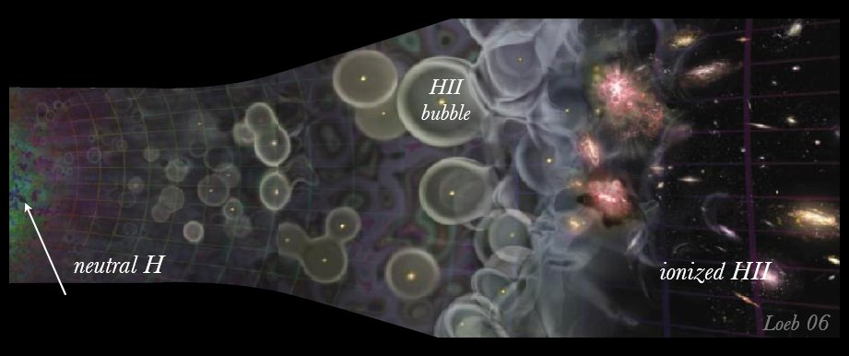
Lyman Continuum Radiation and Reionization
Reionization:
  Several hundred thousand years after the Big Bang, stars and galaxies formed and began to ionize the mostly neutral intergalactic medium (IGM)
  IGM completely ionized by ~1 billion years after Big Bang
Lyman continuum (LyC):
  Photons with sufficient energy to ionize Hydrogen in the ground state (𝜆 ≤ 912 Å)
  Typically does not escape galaxies due to absorption by Hydrogen in and around host galaxy

Slide 4
Target Selection & Observations
Selected as part of larger search for potential LyC emitters in GOODS North field
  Matched Hubble Space Telescope (HST) UV images with catalogs of optical spectra to ensure reliable redshift
Figure 1: Rest-frame UV spectrum of quasar SDSS J123622.93+621526.6 obtained from the SDSS-III BOSS survey (Ahn et al. 2012).
LyC
Figure 2: HST WFC3/UVIS, ACS/WFC, and WFC3/IR images of quasar SDSS J123622.93+621526.6. LyC detection is seen in F275W (purple). These images were obtained from the HDUV, GOODS-N, and CANDELS surveys (Naidu et al. 2017, Giavalisco et al. 2004, and Grogin et al. 2011 respectively)

Slide 5
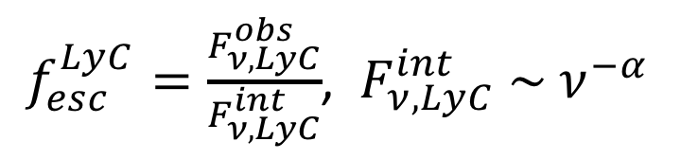
Lyman Continuum Escape Fraction
Defined as fraction of LyC photons that escape into IGM (and thus contribute to Reionization!)
Calculated by taking the ratio of observed LyC flux to (modeled) intrinsic LyC emission
  Toughest part is modeling intrinsic emission, but this can be approximated by a power law:
$f_{esc}^{LyC}=\frac{F_{ν,LyC}^{obs}}{F_{ν,LyC}^{int}}$, ${ F}_{ν,LyC}^{int} \sim ν^{−α}$
Figure 3: Our broken power-law continuum model before IGM correction, plotted alongside HST photometry points, BOSS spectrum, and F275W filter curve (black). The LyC slope was obtained from an existing CDFN X-ray spectrum (Alexander et al. 2003) and extrapolated to UV (Telfer et al. 2002). The UVC slope was obtained by fitting a power-law to the BOSS spectrum.

Slide 6
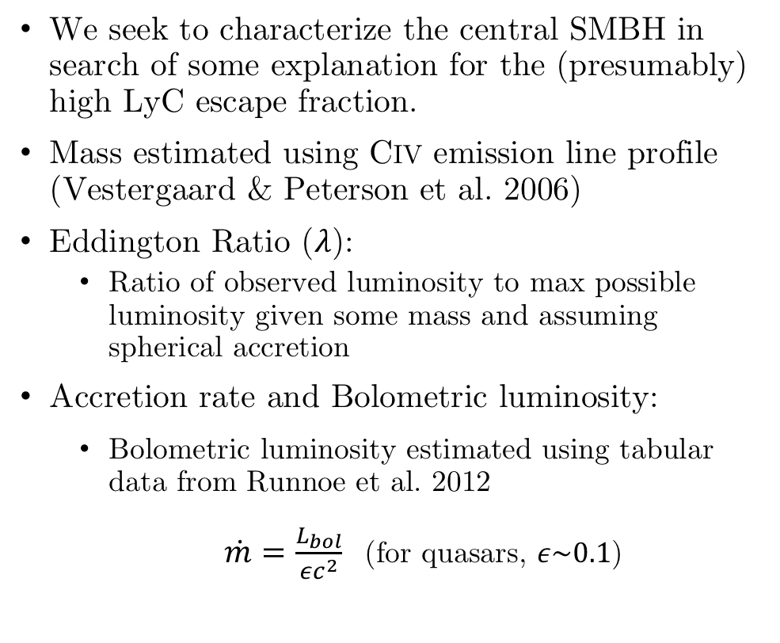
SMBH Parameter Estimation
We seek to characterize the central SMBH in search of some explanation for the (presumably) high LyC escape fraction.
Mass estimated using CIV emission line profile (Vestergaard & Peterson et al. 2006)
Eddington Ratio ($λ$):
  Ratio of observed luminosity to max possible luminosity given some mass and assuming spherical accretion
Accretion rate and Bolometric luminosity:
  Bolometric luminosity estimated using tabular data from Runnoe et al. 2012
  $\dot{m}=\frac{L_{bol}}{εc^{2}}$ (for quasars, $ε\sim 0.1$)
Figure 4: Gauss-Hermite polynomial fit to CIV emission line seen in BOSS spectrum. The SMBH mass was estimated by extracting the line’s width and blueshift (Coatman et al. 2017)

Slide 7
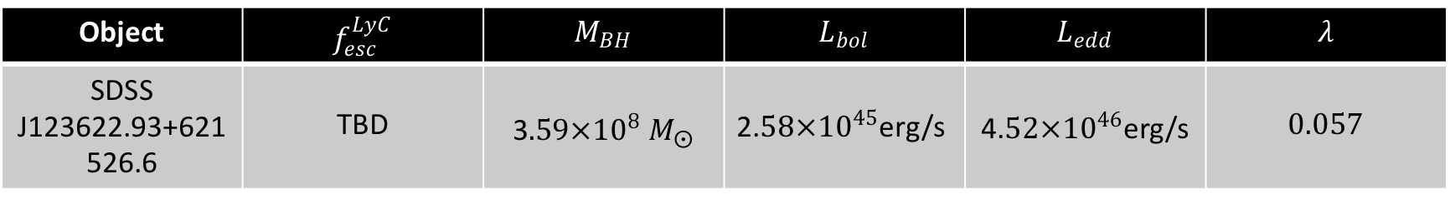
Results and Future Work
Table 1: Summary of results obtained from modeling quasar SDSS J123622.93+621526.6
Object | $$f_{esc}^{LyC}$$ | $$M_{BH}$$ | $$L_{bol}$$ | $$L_{edd}$$ | $$λ$$
SDSS J123622.93+621526.6 | TBD | $$\text{3}.59×{10}^{8} M_{⨀}$$ | $\text{2.}58×{10}^{45}$erg/s | $\text{4.}52×{10}^{46}$erg/s | $$0.057$$
Moving forward…
  Apply IGM corrections to our model, calculate the LyC escape fraction, and finish drafting our manuscript for submission to the Astrophysical Journal Letters

Slide 8
References
Ahn, C. P., Alexandroff, R., Allende Prieto, C., et al. 2012, ApJS, 203, 21
Alexander, D. M., Bauer, F. E., Brandt, W. N., et al. 2003, AJ, 126, 539
Coatman, L., Hewett, P. C., Banerji, M., et al. 2017, MNRAS, 465, 2120
Giavalisco, M., Ferguson, H. C., Koekemoer, A. M., et al. 2004, ApJL, 600, L93
Grogin, N. A., Kocevski, D. D., Faber, S. M., et al. 2011, ApJS, 197, 35
Naidu, R. P., Oesch, P. A., Reddy, N., et al. 2017, ApJ, 847, 12
Runnoe, J. C., Brotherton, M. S., & Shang, Z. 2012, MNRAS, 422, 478
Telfer, R. C., Zheng, W., Kriss, G. A., & Davidsen, A. F. 2002, ApJ, 565, 773
Vestergaard, M., & Peterson, B. M. 2006, ApJ, 641, 689

Slide 9
Acknowledgements
Support for this project came from the ASU/NASA Space Grant Consortium and the Space Telescope Science Institute (HST program AR-13877)

Slide 10
Questions?

